Slide 1


Cross-Platform Development with Kotlin Multiplatform
Martynas Šustavičius
martynas.su@gmail.com

Slide 2
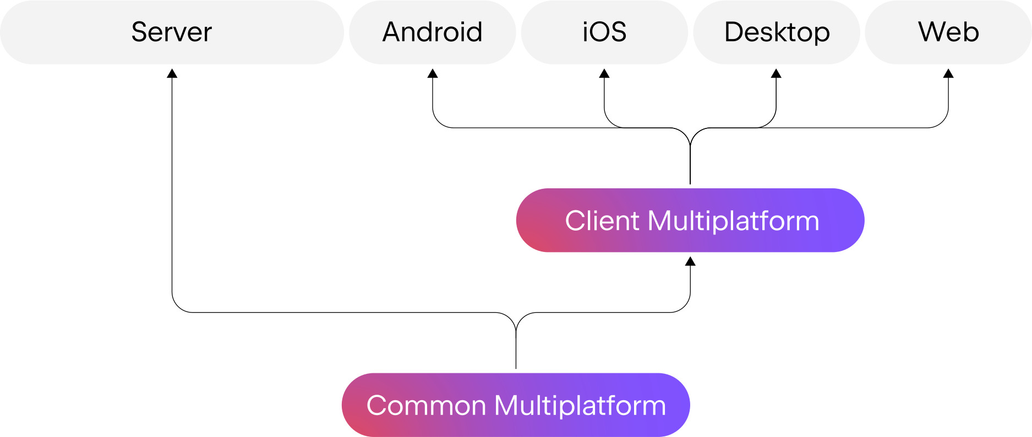
What is Kotlin Multiplatform (KMP)?
Notes:
Kotlin Multiplatform, often referred to as Kotlin Multiplatform Mobile (KMM), is a technology developed by JetBrains that allows developers to write and share code across multiple platforms, including Android, iOS, the web, desktop, and more. The key points about Kotlin Multiplatform include:
Shared Codebase: KMM enables the creation of a shared codebase written in Kotlin that can be used on different platforms, reducing code duplication and maintaining consistency.
Platform-Specific Code: While the core business logic and data models are shared, KMM also allows the integration of platform-specific code, such as UI components and platform-specific APIs.
Target Platforms: Kotlin Multiplatform supports a range of platforms, including Android, iOS (using Swift or Objective-C), the JVM (for server-side applications), JavaScript (for web development), and native platforms like macOS and Linux.
Interoperability: KMM provides mechanisms for seamless interoperability with platform-specific code, allowing developers to use platform-specific libraries and APIs when needed.
IDE Integration: Kotlin Multiplatform is well-integrated with popular IDEs, including IntelliJ IDEA and Android Studio, making development and debugging more efficient.
Code Sharing: KMM is particularly useful for sharing common code in mobile app development for Android and iOS, reducing development effort and improving code consistency.
Community and Ecosystem: Kotlin is backed by a strong community, and there is growing support for KMM, making it an increasingly popular choice for cross-platform development.
In summary, Kotlin Multiplatform allows developers to share and reuse code across various platforms while still accommodating platform-specific requirements and providing a more streamlined and efficient development experience. It offers a versatile approach to cross-platform development, helping developers build applications for multiple platforms with reduced effort and improved code maintainability.

Slide 3
Where is Kotlin Multiplatform Applicable?
Mobile App Development
Web Development
Server-Side Development
Cross-Platform Libraries
Desktop Applications
Game Development
Embedded Systems
Notes:
Kotlin Multiplatform is applicable in a wide range of software development scenarios where you want to share and reuse code across multiple platforms. Some common areas of applicability include:
Mobile App Development: Share business logic and data models between Android and iOS apps to reduce code duplication.
Web Development: Write common logic for web applications and deliver them using Kotlin/JS.
Server-Side Development: Share code between server-side applications running on the JVM and other platforms.
Cross-Platform Libraries: Create cross-platform libraries that can be used in various software projects.
IoT (Internet of Things): Develop IoT applications and device firmware using shared Kotlin code.
Desktop Applications: Build desktop applications for different platforms (e.g., Windows, macOS, Linux) while sharing core logic.
Game Development: Use Kotlin Multiplatform to share code for game development across multiple platforms.
Embedded Systems: Develop embedded systems and firmware with a shared codebase.
Utilities and Tools: Create cross-platform utility apps and developer tools that work on multiple operating systems.
Kotlin Multiplatform offers flexibility and efficiency in sharing code across a diverse set of platforms, making it a valuable choice for projects that target multiple environments and require code consistency.

Slide 4
Alternatives
Flutter
React Native﻿
Xamarin
Ionic
NativeScript﻿
C/C++
Notes:
Flutter:
Developed by Google.
Uses Dart programming language.
Provides a rich set of pre-designed widgets.
Offers a hot reload feature for fast development.
Known for high performance and native-like user interfaces.
React Native:
Developed by Facebook.
Uses JavaScript and React.
Allows building mobile apps using web development skills.
Provides a large ecosystem of open-source components.
Offers strong community support and a fast development cycle.
Ionic:
A framework for building mobile and web apps using web technologies (HTML, CSS, and JavaScript/TypeScript).
Focused on web-based apps and progressive web apps (PWAs).
Leverages Angular for its core functionality.
Offers a wide range of UI components and themes.
Xamarin:
Owned by Microsoft.
Uses C# and .NET for app development.
Provides a single codebase for Android and iOS.
Offers native-like performance and access to native APIs.
Integrated with Visual Studio for development.
NativeScript:
Developed by Progress Software.
Uses JavaScript, TypeScript, or Angular for app development.
Allows direct access to native APIs and UI components.
Offers a real native user experience.
Supports building cross-platform apps with a single codebase.

Slide 5
Benefits of Kotlin Multiplatform
Code Reusability
Consistency
Productivity
Native Performance
Interoperability
Growing Ecosystem
Enhanced Collaboration
Cost Savings
Diverse Platforms
Ease of Learning
Notes:
Code Reusability: KMM allows you to write and share a significant portion of your codebase across multiple platforms, reducing code duplication and development effort. Write code once, use it across multiple platforms
Consistency: With a shared codebase, you can ensure consistency in your application's core logic and data models across different platforms.
Productivity: By avoiding redundant coding, you can speed up development and reduce maintenance overhead.
Native Performance: KMM provides the flexibility to write platform-specific code when needed, ensuring native-like performance on each platform.
Interoperability: It seamlessly integrates with platform-specific code and libraries, making it easy to leverage existing native tools and technologies.
IDE Support: KMM is well-supported in popular IDEs like IntelliJ IDEA and Android Studio, enhancing the development experience.
Growing Ecosystem: Kotlin Multiplatform is gaining traction, and its ecosystem is expanding, with growing community support and third-party libraries.
Cost Savings: By sharing code and reducing development time, you can lower development costs, especially when targeting multiple platforms.
Target Diverse Platforms: You can use KMM to develop applications for Android, iOS, web, desktop, server, and more, making it versatile for various project types.
Ease of Learning: If you're already familiar with Kotlin, learning KMM is relatively straightforward, reducing the learning curve.
These benefits make Kotlin Multiplatform a compelling choice for cross-platform development, allowing developers to streamline their workflow, save time and resources, and create consistent, high-performance applications for different platforms.

Slide 6
Supported platforms
Kotlin/JVM
Kotlin/JS
Kotlin/Native
  iOS
  macOS
  Linux
  Windows
  WebAssembly

Slide 7
Experience Sharing (Company Use Case)
Why KMP?
  Almost all developers left who were working on C++ shared code
  Simultaneous releases
  Identical functionality
  Reduced developer effort
Challenges
  Onboarding iOS devs
  Setting up CI pipeline
Present results
  Faster delivery of new features
  Nearly identical behavior between platforms

Slide 8
Best Practices
Clean Architecture
MVVM
Contract classes
Unit testing
Notes:
Start with a Clear Architecture:
Design a clean and modular architecture for your project. Consider using architecture patterns like MVVM or MVI that promote separation of concerns and code maintainability.
Keep Business Logic in Shared Code:
Centralize your app's core business logic and data models in the shared code module to maximize code reuse.
Use Expect and Actual Declarations:
Leverage the expect and actual declarations to define platform-agnostic APIs in shared code and provide platform-specific implementations in platform-specific modules.
Thorough Testing:
Write comprehensive unit tests for your shared code to ensure that it functions correctly on all platforms. Also, write platform-specific tests as needed.
Platform-Specific Considerations:
Understand the nuances and platform-specific requirements of the platforms you're targeting. Be prepared to write platform-specific code when necessary.
Version and Dependency Management:
Keep your Kotlin Multiplatform version and dependencies up to date to benefit from bug fixes and performance improvements.
Use Cross-Platform Libraries:
Whenever possible, use cross-platform libraries and tools that support Kotlin Multiplatform to save time and effort.
Exception Handling:
Handle exceptions consistently across platforms. Be aware of platform-specific exceptions and error handling practices.
Optimize for UI and User Experience:
For user interfaces, tailor your app to the design guidelines and conventions of each platform to ensure a native-like user experience.
Continuous Integration and Testing:
Set up continuous integration (CI) and automated testing for all target platforms to catch issues early.
Documentation and Communication:
Document your project well, including how to set up the development environment and guidelines for platform-specific code. Maintain clear communication within the development team.
Performance Tuning:
Monitor the performance of your app on different platforms and optimize where needed. Leverage profiling tools for each platform.
Community and Resources:
Stay engaged with the Kotlin Multiplatform community and resources to learn from others and stay updated on best practices.
Code Reviews and Collaboration:
Encourage code reviews and collaboration between platform-specific and shared code teams to ensure code quality and consistency.
Quality Assurance:
Perform thorough quality assurance testing on each platform to catch platform-specific issues and ensure a high-quality user experience.

