Slide 1
Rx Java intro
Vaidas Kriščeliūnas

Slide 2
Why we use RxJava?
Easier multithreading
Operation composition
Error handling
Testability

Slide 3
Agenda
Rx Java components
Samples
Basics
Operation composition
Error handling
Testing
Common mistakes

Slide 4
Rx Java components
Observable
Observer
Disposable
Scheduler
Observable.create(ObservableOnSubscribe<T>)
public interface ObservableOnSubscribe<T> {
void subscribe(@NonNull ObservableEmitter<T> emitter) throws Exception;
}
public interface Emitter<T> { void onNext(@NonNull T value); void onError(@NonNull Throwable error); void onComplete(); }

Slide 5
Rx Java components
Observable
Observer
Disposable
Scheduler
Observable.just(T item)
Observable.fromCallable(Callable<T>)
Observable.fromIterable(Iterable)
Observable.fromArray(Array)
Observable.defer(Callable<Observable<T>)
Observable.error(Throwable)
Observable.empty()
Observable.never()

Slide 6
Rx Java components
Observable
Observer
Disposable
Scheduler
public interface Observer<T> {
void onSubscribe(@NonNull Disposable disposable);
void onNext(@NonNull T t);
void onError(@NonNull Throwable error);
void onComplete();
}

Slide 7
Rx Java components
Observable
Observer
Disposable
Scheduler
Observable.just("sample")
.subscribe(new Observer<String>() {
@Override
public void onSubscribe(Disposable d) {
}
@Override
public void onNext(String s) {
}
@Override
public void onError(Throwable e) {
}
@Override
public void onComplete() {
}
});

Slide 8
Rx Java components
Observable
Observer
Disposable
Scheduler
Observable.just("sample") .subscribe(new Consumer<String>() { @Override public void accept(String s) throws Exception { } }, new Consumer<Throwable>() { @Override public void accept(Throwable throwable) throws Exception { } }, new Action() { @Override public void run() throws Exception { } }, new Consumer<Disposable>() { @Override public void accept(Disposable disposable) throws Exception { } });

Slide 9
Rx Java components
Observable
Observer
Disposable
Scheduler
Observable.just("sample")
.subscribe(s -> {
}, throwable -> {
}, () -> {
}, disposable -> {
});

Slide 10
Rx Java components
Observable
Observer
Disposable
Scheduler
Observable.just("sample")
.subscribe(s -> {
// onNext
}, throwable -> {
// onError
}, () -> {
// onComplete
}, disposable -> {
// onSubscribe
});
Observable.just("sample")
.subscribe(s -> {
// onNext
}, throwable -> {
// onError
}, () -> {
// onComplete
});
Observable.just("sample")
.subscribe(s -> {
// onNext
}, throwable -> {
// onError
});
Observable.just("sample")
.subscribe(s -> {
// onNext
});
Observable.just("sample")
.subscribe();

Slide 11
Rx Java components
Observable
Observer
Disposable
Scheduler
public interface Disposable {
void dispose();
boolean isDisposed();
}
Disposables.disposed()
Disposables.empty()

Slide 12
Rx Java components
Observable
Observer
Disposable
Scheduler
Observable.just("sample")
.subscribe(s -> {
// onNext
}, throwable -> {
// onError
}, () -> {
// onComplete
}, disposable -> {
// onSubscribe
});
Disposable disposable = Observable.just("sample")
.subscribe(s -> {
// onNext
}, throwable -> {
// onError
}, () -> {
// onComplete
});

Slide 13
Rx Java components
Observable
Observer
Disposable
Scheduler
Provider schedulers
Schedulers.io()
Schedulers.computation()
Schedulers.single()
Schedulers.trampoline()
Schedulers.newThread()
Custom
Schedulers.from(Executor)
Observable.fromCallable(() -> "some result") .subscribeOn(Schedulers.io()) .observeOn(Schedulers.computation());

Slide 14
Sample #1 Android Sample data loading
@Override public void onViewCreated(@NonNull View view, @Nullable Bundle savedInstanceState) { super.onViewCreated(view, savedInstanceState); new Thread(() -> { User user = service.loadUser(); showUserOnUi(user); }).start(); } private void showUserOnUi(User user) { // do something with user }
public interface SyncUserService { User loadUser(); }

Slide 15
Sample #1 Android Sample data loading
@Override public void onViewCreated(@NonNull View view, @Nullable Bundle savedInstanceState) { super.onViewCreated(view, savedInstanceState); new Thread(() -> { User user = service.loadUser(); showUserOnUi(user); // NEEDS UI THREAD }).start(); } private void showUserOnUi(User user) { // do something with user }
public interface SyncUserService { User loadUser(); }

Slide 16
Sample #1 Android Sample data loading
private Handler handler = new Handler(); // runs tasks on UI thread @Override public void onViewCreated(@NonNull View view, @Nullable Bundle savedInstanceState) { super.onViewCreated(view, savedInstanceState); new Thread(() -> { User user = service.loadUser(); handler.post(() -> showUserOnUi(user)); // I FIX }).start(); }

Slide 17
Sample #1 Android Sample data loading
private Handler handler = new Handler(); @Override public void onViewCreated(@NonNull View view, @Nullable Bundle savedInstanceState) { super.onViewCreated(view, savedInstanceState); new Thread(() -> { User user = service.loadUser(); handler.post(() -> showUserOnUi(user)); }).start(); }
What if user closes screen?

Slide 18
Sample #1 Android Sample data loading
private Handler handler = new Handler(); @Override public void onViewCreated(@NonNull View view, @Nullable Bundle savedInstanceState) { super.onViewCreated(view, savedInstanceState); new Thread(() -> { User user = service.loadUser(); handler.post(() -> { if (isAdded()) { // I FIX AGAIN showUserOnUi(user); } }); }).start(); }

Slide 19
Sample #1 Android Sample data loading
@Override public void onViewCreated(@NonNull View view, @Nullable Bundle savedInstanceState) { super.onViewCreated(view, savedInstanceState); Observable.fromCallable(() -> service.loadUser()); // create source stream }

Slide 20
Sample #1 Android Sample data loading
@Override public void onViewCreated(@NonNull View view, @Nullable Bundle savedInstanceState) { super.onViewCreated(view, savedInstanceState); Observable.fromCallable(() -> service.loadUser()) .subscribe(user -> showUser(user)); // observe stream }

Slide 21
Sample #1 Android Sample data loading
@Override public void onViewCreated(@NonNull View view, @Nullable Bundle savedInstanceState) { super.onViewCreated(view, savedInstanceState); Observable.fromCallable(() -> service.loadUser()) .subscribeOn(Schedulers.io()) // add work scheduler for stream .subscribe(user -> showUser(user)); }

Slide 22
Sample #1 Android Sample data loading
@Override public void onViewCreated(@NonNull View view, @Nullable Bundle savedInstanceState) { super.onViewCreated(view, savedInstanceState); Observable.fromCallable(() -> service.loadUser()) .subscribeOn(Schedulers.io()) .observeOn(AndroidSchedulers.mainThread()) // add observe scheduler .subscribe(user -> showUser(user)); }

Slide 23
Sample #1 Android Sample data loading
private Disposable disposable = Disposables.disposed(); // observe handle @Override public void onViewCreated(@NonNull View view, @Nullable Bundle savedInstanceState) { super.onViewCreated(view, savedInstanceState); disposable = Observable.fromCallable(() -> service.loadUser()) .subscribeOn(Schedulers.io()) .observeOn(AndroidSchedulers.mainThread()) .subscribe(user -> showUser(user)); } @Override public void onDestroyView() { disposable.dispose(); super.onDestroyView(); }

Slide 24
Sample #1 Android Sample data loading
private Disposable disposable = Disposables.disposed(); @Override public void onViewCreated(@NonNull View view, @Nullable Bundle savedInstanceState) { super.onViewCreated(view, savedInstanceState); disposable = Observable.fromCallable(() -> service.loadUser()) .subscribeOn(Schedulers.io()) .observeOn(AndroidSchedulers.mainThread()) .subscribe(user -> showUser(user), throwable -> { /* handle error */}); } @Override public void onDestroyView() { disposable.dispose(); super.onDestroyView(); }

Slide 25
Sample #2 Converting listeners to streams
public interface LocationListener { void onLocationChange(Location location); }
public interface LocationService { void addListener(LocationListener listener); void dropListener(LocationListener listener); }

Slide 26
Sample #2 Converting listeners to streams
private LocationListener locationListener = location -> updateLocation(location); @Override public void onStart() { super.onStart(); locationService.addListener(locationListener); } @Override public void onStop() { locationService.dropListener(locationListener); super.onStop(); }

Slide 27
Sample #2 Converting listeners to streams
public Observable<Location> observe(LocationService service) { return Observable.create(emitter -> { service.addListener(location -> emitter.onNext(location)); }); }

Slide 28
Sample #2 Converting listeners to streams
public Observable<Location> observeLocation(LocationService service) { return Observable.create(emitter -> { LocationListener locationListener = location -> emitter.onNext(location); service.addListener(locationListener); emitter.setCancellable(() -> service.dropListener(locationListener)); }); }

Slide 29
Sample #2 Converting listeners to streams
private Disposable disposable = Disposables.disposed(); @Override public void onStart() { super.onStart(); disposable = observeLocation(locationService).subscribe(location -> updateLocation(location)); } @Override public void onStop() { disposable.dispose(); super.onStop(); }

Slide 30
Sample #3 Combining streams
public interface ContactApi { Observable<List<Contact>> fetchContacts(); }
public interface ContactDatabase { Observable<List<Contact>> loadContacts(); Observable<List<Contact>> saveContacts(List<Contact> contacts); }

Slide 31
Sample #3 Combining streams
private ContactDatabase contactDatabase; private ContactApi contactApi; public Observable<List<Contact>> contactSource() { return contactApi.fetchContacts() .flatMap(contacts -> contactDatabase.saveContacts(contacts)); }

Slide 32
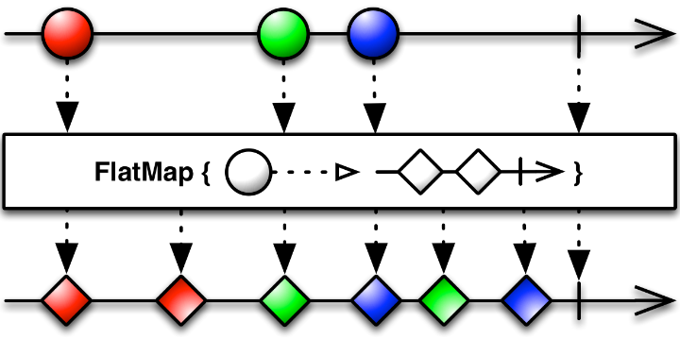
Sample #3 Combining streams

Slide 33
Sample #3 Combining streams
private ContactDatabase contactDatabase; private ContactApi contactApi; public Observable<List<Contact>> contactSource() { return contactApi.fetchContacts() .flatMap(contacts -> contactDatabase.saveContacts(contacts)) .mergeWith(contactDatabase.loadContacts()); }

Slide 34
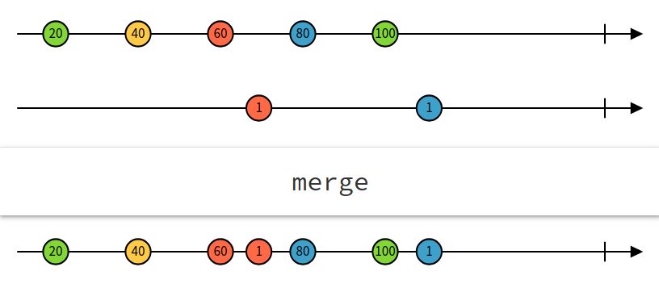
Sample #3 Combining streams

Slide 35
Sample #3 Combining streams
public interface RxLocationService { Observable<Location> locationSource(); Location lastLocation(); }
public class Contact { public final String name; public final Location location; }
public class DistanceContact { public final String name; public final double distance; }

Slide 36
Sample #3 Combining streams
private RxLocationService locationService; private ContactDatabase contactDatabase; private ContactApi contactApi; public Observable<List<DistanceContact>> contactSource() { return contactApi.fetchContacts() .flatMap(contacts -> contactDatabase.saveContacts(contacts)) .mergeWith(contactDatabase.loadContacts()) .map(contacts -> toDistanceContacts(contacts, locationService.lastLocation())); }
List<DistanceContact> toDistanceContacts(List<Contact> contacts, Location location)

Slide 37
Sample #4 Combining streams

Slide 38
Sample #3 Combining streams
private RxLocationService locationService; private ContactDatabase contactDatabase; private ContactApi contactApi; public Observable<List<DistanceContact>> contactSource() { Observable<List<Contact>> contactSource = contactApi.fetchContacts() .flatMap(contacts -> contactDatabase.saveContacts(contacts)) .mergeWith(contactDatabase.loadContacts()); return Observable.combineLatest( contactSource, locationService.locationSource(), (contacts, location) -> toDistanceContacts(contacts, location) ); }
List<DistanceContact> toDistanceContacts(List<Contact> contacts, Location location)

Slide 39
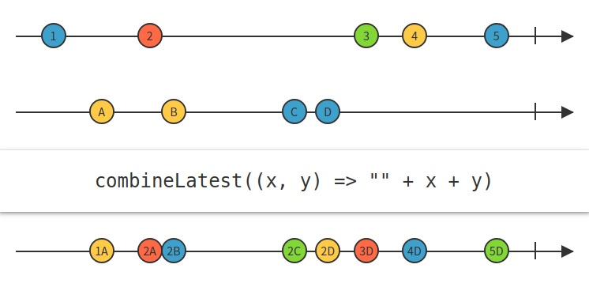
Sample #3 Combining streams

Slide 40
Sample #4 Source testing
public interface TimeProvider { long currentTime(); }
private TimeProvider timeProvider; private Scheduler scheduler; public Observable<Long> timeUpdates() { return Observable.interval(0, 500, TimeUnit.MILLISECONDS, scheduler) .map(interval -> timeProvider.currentTime()); }

Slide 41
Sample #4 Source testing
public interface TimeProvider { long currentTime(); }
private TimeProvider timeProvider; private Scheduler scheduler; public Observable<Long> timeUpdates() { return Observable.interval(0, 500, TimeUnit.MILLISECONDS, scheduler) .map(interval -> timeProvider.currentTime()); }

Slide 42
Sample #4 Source testing
@Test public void timeUpdates_returns_time_every_500ms() { TimeProvider timeProvider = Mockito.mock(TimeProvider.class); Mockito.when(timeProvider.currentTime()).thenReturn(1L, 2L, 3L); TestScheduler scheduler = new TestScheduler(); SourceSample sourceSample = new SourceSample(timeProvider, scheduler); }

Slide 43
Sample #4 Source testing
@Test public void timeUpdates_returns_time_every_500ms() { TimeProvider timeProvider = Mockito.mock(TimeProvider.class); Mockito.when(timeProvider.currentTime()).thenReturn(1L, 2L, 3L); TestScheduler scheduler = new TestScheduler(); SourceSample sourceSample = new SourceSample(timeProvider, scheduler); TestObserver<Long> testObserver = sourceSample.timeUpdates().test(); testObserver.assertNoValues(); }

Slide 44
Sample #4 Source testing
@Test public void timeUpdates_returns_time_every_500ms() { TimeProvider timeProvider = Mockito.mock(TimeProvider.class); Mockito.when(timeProvider.currentTime()).thenReturn(1L, 2L, 3L); TestScheduler scheduler = new TestScheduler(); SourceSample sourceSample = new SourceSample(timeProvider, scheduler); TestObserver<Long> testObserver = sourceSample.timeUpdates().test(); testObserver.assertNoValues(); scheduler.triggerActions(); testObserver.assertValue(1L); }

Slide 45
Sample #4 Source testing
@Test public void timeUpdates_returns_time_every_500ms() { TimeProvider timeProvider = Mockito.mock(TimeProvider.class); Mockito.when(timeProvider.currentTime()).thenReturn(1L, 2L); TestScheduler scheduler = new TestScheduler(); SourceSample sourceSample = new SourceSample(timeProvider, scheduler); TestObserver<Long> testObserver = sourceSample.timeUpdates().test(); testObserver.assertNoValues(); scheduler.triggerActions(); testObserver.assertValue(1L); scheduler.advanceTimeBy(500, TimeUnit.MILLISECONDS); testObserver.assertValues(1L, 2L); }

Slide 46
Sample #4 Observer testing
public interface TimeDisplay { void displayTime(long time); }
private Disposable disposable = Disposables.disposed(); private SourceSample source; private TimeDisplay display; public void start() { disposable.dispose(); disposable = source.timeUpdates().subscribe(time -> display.displayTime(time)); } public void stop() { disposable.dispose(); }

Slide 47
Sample #4 Observer testing
@Before public void setUp() { timeDisplay = Mockito.mock(TimeDisplay.class); sourceSample = Mockito.mock(SourceSample.class); observerSample = new ObserverSample(sourceSample, timeDisplay); }

Slide 48
Sample #4 Observer testing
@Before public void setUp() { timeDisplay = Mockito.mock(TimeDisplay.class); sourceSample = Mockito.mock(SourceSample.class); observerSample = new ObserverSample(sourceSample, timeDisplay); }
@Test public void start_displays_source_sample_time_updates_to_timeDisplay() { Mockito.when(sourceSample.timeUpdates()).thenReturn(Observable.just(14L)); observerSample.start(); Mockito.verify(timeDisplay).displayTime(14L); }

Slide 49
Sample #4 Observer testing
@Test public void stop_stops_observing_time_updates() { TestScheduler scheduler = new TestScheduler(); Mockito.when(sourceSample.timeUpdates()) .thenReturn(Observable.just(14L).subscribeOn(scheduler)); observerSample.start(); observerSample.stop(); scheduler.triggerActions(); Mockito.verifyZeroInteractions(timeDisplay); }

Slide 50
Questions?

